Slide 1
Gradient Descent

Slide 2
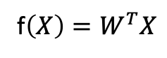
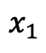
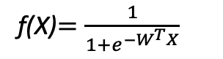
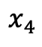
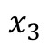
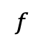
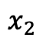
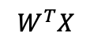
Learning the coefficients
Start with single neuron
Classification: activation is sigmoid
Regression: activation is linear
f(X)$=\frac{1}{{1+e}^{−W^{T}X}}$
f$\left(X\right)=W^{T}X$
$$x_{1}$$
$$x_{2}$$
$$W^{T}X$$
$$f$$
$$Y=f(W_{0}+W_{1}x_{1}+W_{2}x_{2}+W_{3}x_{3}+W_{4}x_{4})$$
$$x_{3}$$
$$x_{4}$$
Intercept or Bias
Coefficients or Weights

Slide 3
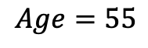
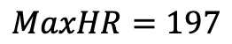
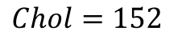
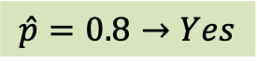
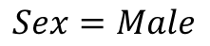
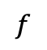
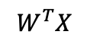
But what is the idea?
Start with all randomly selected weights. Most likely it will perform horribly.
For example, in our heart data, the model will be giving us the wrong answer.
$$MaxHR=197$$
Prediction
Correct
$$Age=55$$
$$W^{T}X$$
$$f$$
$$\hat{p}=0.8→Yes$$
y=No
$$Sex=Male$$
$$Chol=152$$
Bad Computer

Slide 4
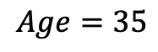
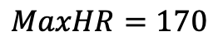
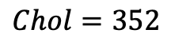
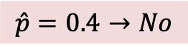
But what is the idea?
Start with all randomly selected weights. Most likely it will perform horribly.
For example, in our heart data, the model will be giving us the wrong answer.
$$MaxHR=170$$
Prediction
Correct
$$Age=35$$
$$W^{T}X$$
$$f$$
$$\hat{p}=0.4→No$$
y=Yes
$$Sex=Male$$
$$Chol=352$$
Bad Computer

Slide 5
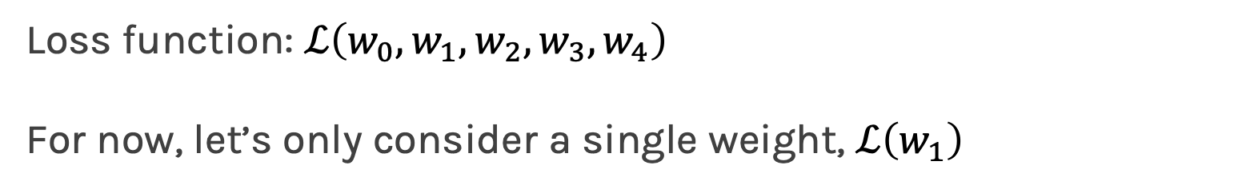
But what is the idea?
The Loss Function takes all these results and averages them and tells us how bad or good the computer or those weights are.
Telling the computer how bad or good it is, does not help.
You want to tell it how to change those weights, so it gets better.
Loss function: $ℒ\left(w_{0},w_{1},w_{2},w_{3},w_{4}\right)$
For now, let’s only consider a single weight, $ℒ\left(w_{1}\right)$

Slide 6
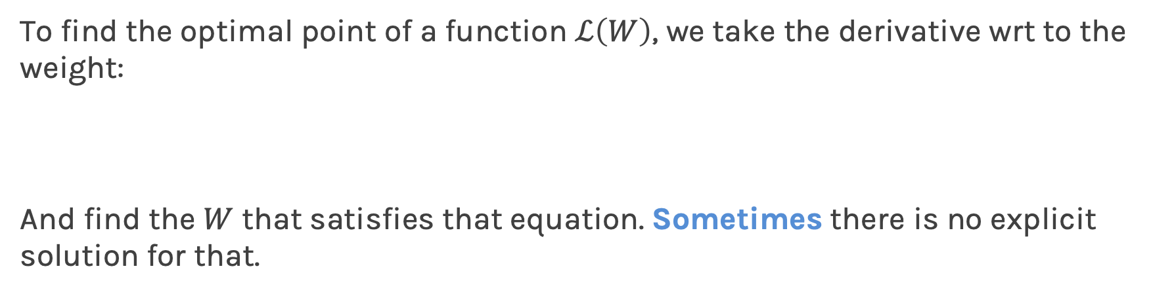
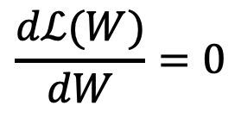
Minimizing the Loss function
Ideally, we want to know the value of $W$ that gives the minimal $ℒ\left(W\right)$
Slope or derivative here is zero
To find the optimal point of a function $ℒ\left(W\right)$, we take the derivative wrt to the weight:
And find the $W$ that satisfies that equation. Sometimes there is no explicit solution for that.
$$\frac{dℒ(W)}{dW}=0$$

Slide 7
Estimate of the regression coefficients: gradient descent
A more flexible method would be
Start from a random point
Compute the slope/derivative at this point
Step to the opposite direction of the derivative

Slide 8
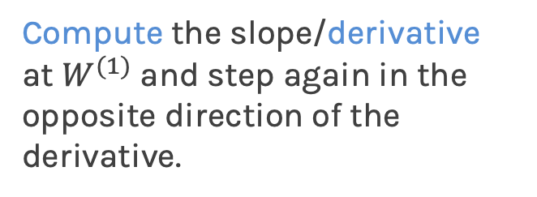
Estimate of the regression coefficients: gradient descent
A more flexible method would be
Compute the slope/derivative at $W^{(1)}$ and step again in the opposite direction of the derivative.
Continue,
Stop when no more improvement or after a certain number of iterations.

Slide 9
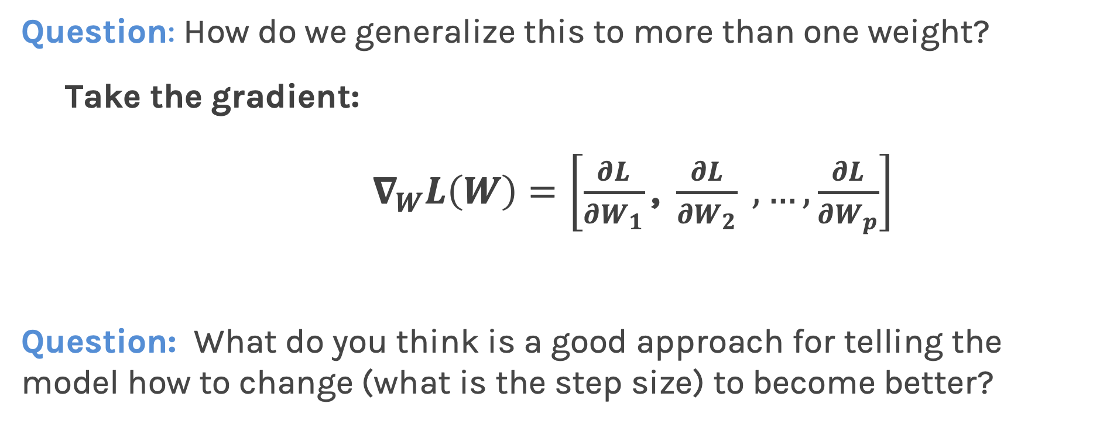
Estimate of the regression coefficients: gradient descent
Question: How do we generalize this to more than one weight?
Take the gradient:
$∇_{W}L\left(W\right)=\left[\frac{∂L}{∂W_{1}}\text{, }\frac{∂L}{∂W_{2}} ,…, \frac{∂L}{∂W_{p}}\right]$
Question: What do you think is a good approach for telling the model how to change (what is the step size) to become better?

Slide 10
Gradient Descent (cont.)
If the step is proportional to the slope, then you avoid overshooting the minimum. How?

Slide 11
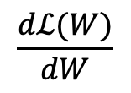
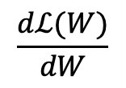
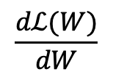
Gradient Descent (cont.)
If the step is proportional to the slope, then you avoid overshooting the minimum. How?
$$\frac{dℒ(W)}{dW}$$
$$\frac{dℒ(W)}{dW}$$
$$\frac{dℒ(W)}{dW}$$

Slide 12
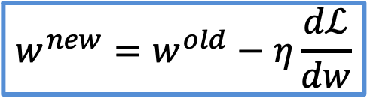
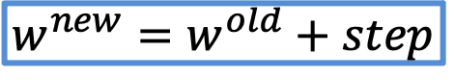
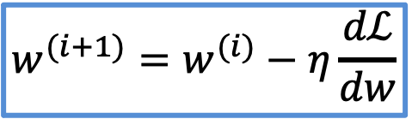
Gradient Descent
We know that we want to go in the opposite direction of the derivative, and we know we want to be making a step proportional to the derivative.
Making a step means:
Step size is proportional to derivative
$${w^{new}=w}^{old}+step$$
Opposite direction of the derivative and proportional to the derivative means:
$${w^{new}=w}^{old}−η\frac{dℒ}{dw}$$
Learning Rate
Change to more conventional notation:
$${w^{(i+1)}=w}^{(i)}−η\frac{dℒ}{dw}$$

Slide 13

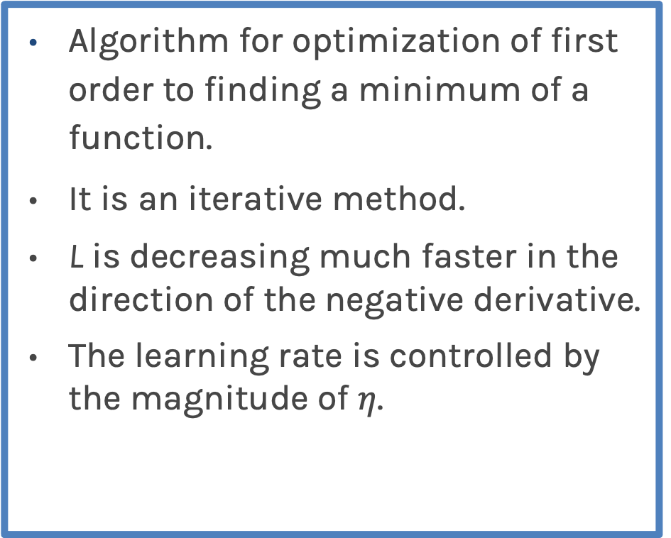
Gradient Descent
Algorithm for optimization of first order to finding a minimum of a function.
It is an iterative method.
L is decreasing much faster in the direction of the negative derivative.
The learning rate is controlled by the magnitude of $η$.
$${w^{(i+1)}=w}^{(i)}−η\frac{dℒ}{dw}$$
L
-
+
w

Slide 14
Gradient Descent Considerations
We still need to calculate the derivatives.
We need to set the learning rate.
Local vs global minima.
The full likelihood function includes summing up all individual ‘errors’. Sometimes this includes hundreds of thousands of examples.

Slide 15
Gradient Descent Considerations
We still need to calculate the derivatives.
We need to set the learning rate.
Local vs global minima.
The full likelihood function includes summing up all individual ‘errors’. Sometimes this includes hundreds of thousands of examples.

Slide 16
Calculate the Derivatives
Can we do it? Can we calculate the derivative of any loss function?
Wolfram Alpha can do it for us!
We need a formalism to deal with these derivatives.

Slide 17
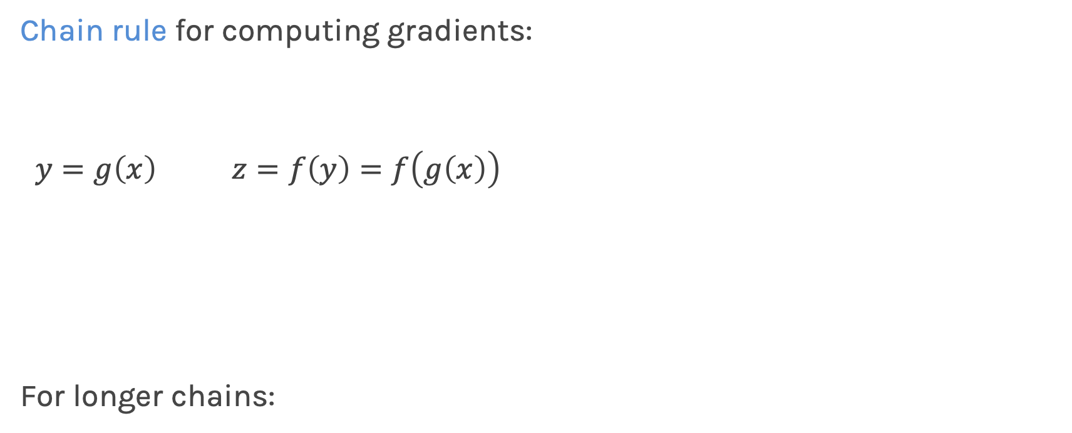
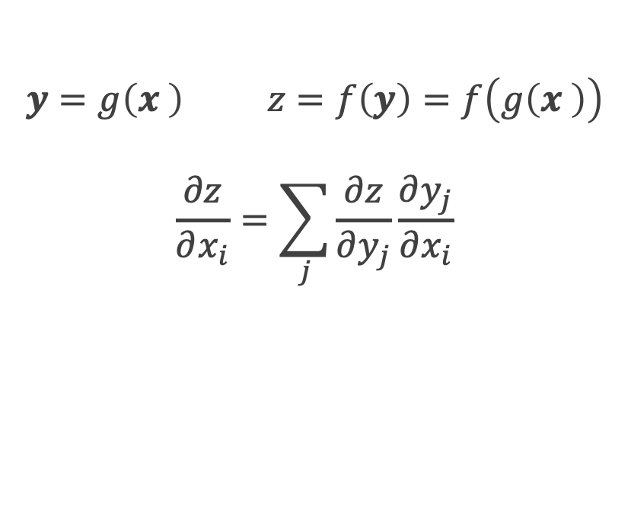
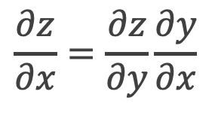
Chain Rule
Chain rule for computing gradients:
$y=g\left(x\right) z=f\left(y\right)=f\left(g\left(x\right)\right)$
For longer chains:
$$y=g\left(x \right) z=f\left(y\right)=f\left(g\left(x \right)\right)$$
$$\frac{∂z}{∂x_{i}}=\sum_{j}{\frac{∂z}{∂y_{j}}\frac{∂y_{j}}{∂x_{i}}}$$
$$\frac{∂z}{∂x}=\frac{∂z}{∂y}\frac{∂y}{∂x}$$

Slide 18
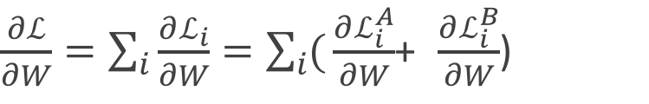
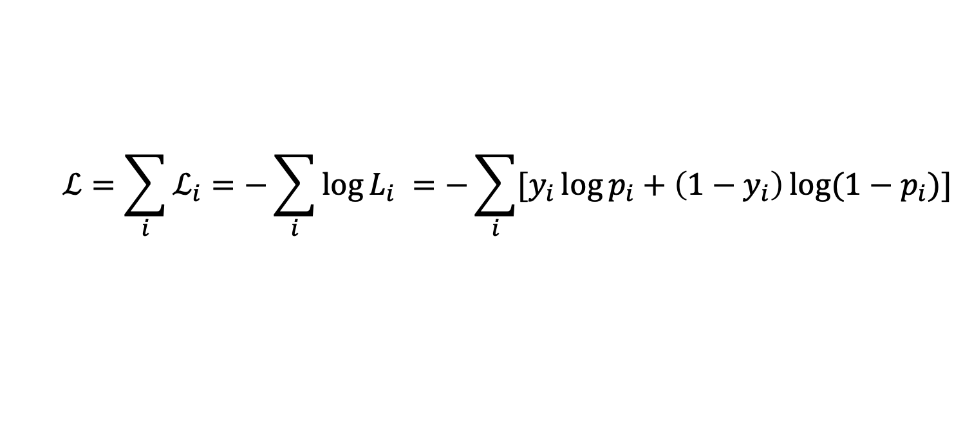
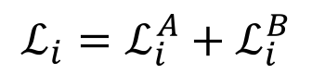
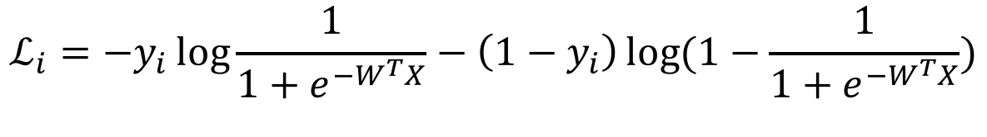
Logistic Regression derivatives
For logistic regression, the –ve log of the likelihood is:
$$ℒ=\sum_{i}{ℒ_{i}}=−\sum_{i}{\log{L_{i}}}{=−\sum_{i}{[y_{i}\log{p_{i}+\left(1−y_{i}\right)\log{(1−p_{i})]}}}}$$
$$ℒ_{i}={−y}_{i}\log{\frac{1}{1+e^{−W^{T}X}}−\left(1−y_{i}\right)\log{(1−\frac{1}{1+e^{−W^{T}X}})}}$$
To simplify the analysis let us split it into two parts,
$$ℒ_{i}=ℒ_{i}^{A}+ℒ_{i}^{B}$$
So the derivative with respect to W is:
$\frac{∂ℒ}{∂W}=\sum_{i}{\frac{∂ℒ_{i}}{∂W}}=\sum_{i}{(}\frac{∂ℒ_{i}^{A}}{∂W}$+ $\frac{∂ℒ_{i}^{B}}{∂W}$)

Slide 19
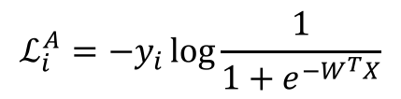
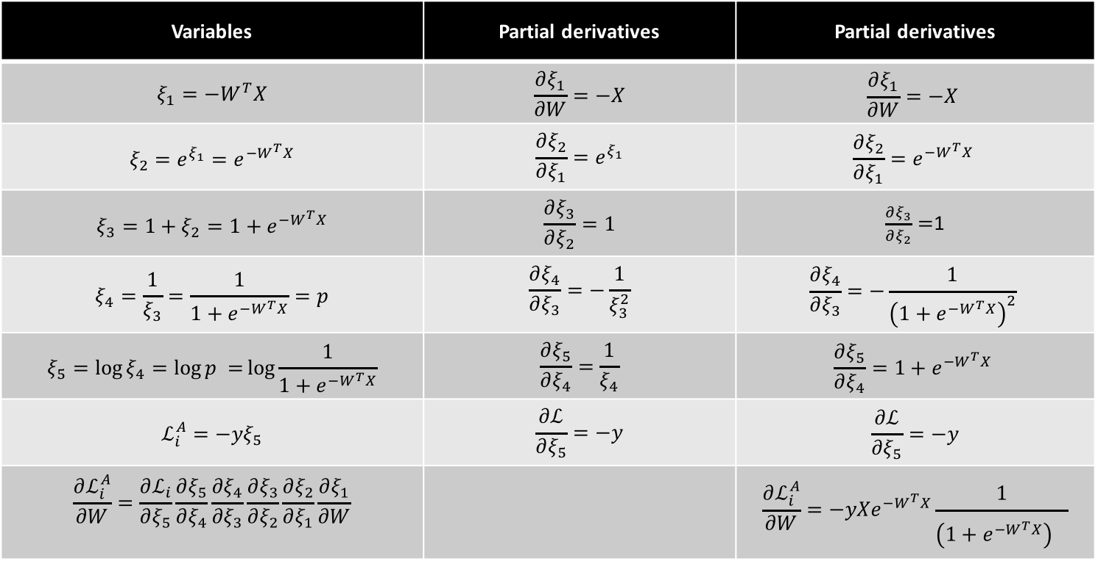
$$ℒ_{i}^{A}={−y}_{i}\log{\frac{1}{1+e^{−W^{T}X}}}$$
Variables | Partial derivatives | Partial derivatives
$$ξ_{1}=−W^{T}X$$ | $$\frac{∂ξ_{1}}{∂W}=−X$$ | $$\frac{∂ξ_{1}}{∂W}=−X$$
$$ξ_{2}={e^{ξ_{1}}=e}^{−W^{T}X}$$ | $$\frac{∂ξ_{2}}{∂ξ_{1}}=e^{ξ_{1}}$$ | $$\frac{∂ξ_{2}}{∂ξ_{1}}=e^{−W^{T}X}$$
$$ξ_{3}=1+ξ_{2}=1+e^{−W^{T}X}$$ | $$\frac{∂ξ_{3}}{∂ξ_{2}}=1$$ | $\frac{∂ξ_{3}}{∂ξ_{2}}=$1
$$ξ_{4}=\frac{1}{ξ_{3}}=\frac{1}{1+e^{−W^{T}X}}=p$$ | $$\frac{∂ξ_{4}}{∂ξ_{3}}=−\frac{1}{ξ_{3}^{2}}$$ | $$\frac{∂ξ_{4}}{∂ξ_{3}}=−\frac{1}{{\left(1+e^{−W^{T}X}\right)}^{2}}$$
$$ξ_{5}=\log{ξ_{4}=\log{p =}\log{\frac{1}{1+e^{−W^{T}X}}}}$$ | $$\frac{∂ξ_{5}}{∂ξ_{4}}=\frac{1}{ξ_{4}}$$ | $$\frac{∂ξ_{5}}{∂ξ_{4}}=1+e^{−W^{T}X}$$
$$ℒ_{i}^{A}=−yξ_{5}$$ | $$\frac{∂ℒ}{∂ξ_{5}}=−y$$ | $$\frac{∂ℒ}{∂ξ_{5}}=−y$$
$$\frac{∂ℒ_{i}^{A}}{∂W}=\frac{∂ℒ_{i}}{∂ξ_{5}}\frac{∂ξ_{5}}{∂ξ_{4}}\frac{∂ξ_{4}}{∂ξ_{3}}\frac{∂ξ_{3}}{∂ξ_{2}}\frac{∂ξ_{2}}{∂ξ_{1}}\frac{∂ξ_{1}}{∂W}$$ |  | $${\frac{∂ℒ_{i}^{A}}{∂W}=−yXe}^{−W^{T}X}\frac{1}{{\left(1+e^{−W^{T}X}\right)}^{}}$$

Slide 20
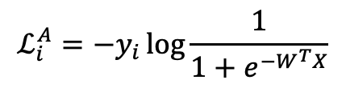
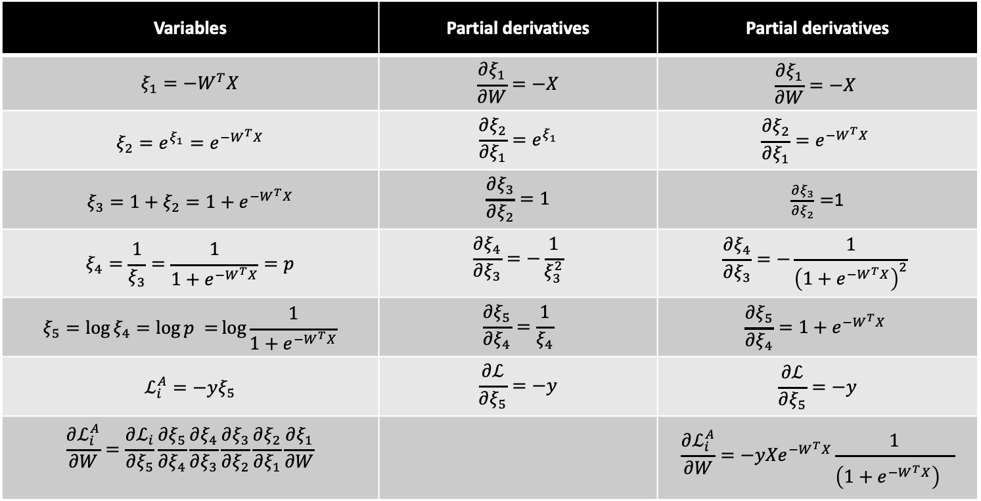
$$ℒ_{i}^{A}={−y}_{i}\log{\frac{1}{1+e^{−W^{T}X}}}$$
Variables | Partial derivatives | Partial derivatives
$$ξ_{1}=−W^{T}X$$ | $$\frac{∂ξ_{1}}{∂W}=−X$$ | $$\frac{∂ξ_{1}}{∂W}=−X$$
$$ξ_{2}={e^{ξ_{1}}=e}^{−W^{T}X}$$ | $$\frac{∂ξ_{2}}{∂ξ_{1}}=e^{ξ_{1}}$$ | $$\frac{∂ξ_{2}}{∂ξ_{1}}=e^{−W^{T}X}$$
$$ξ_{3}=1+ξ_{2}=1+e^{−W^{T}X}$$ | $$\frac{∂ξ_{3}}{∂ξ_{2}}=1$$ | $\frac{∂ξ_{3}}{∂ξ_{2}}=$1
$$ξ_{4}=\frac{1}{ξ_{3}}=\frac{1}{1+e^{−W^{T}X}}=p$$ | $$\frac{∂ξ_{4}}{∂ξ_{3}}=−\frac{1}{ξ_{3}^{2}}$$ | $$\frac{∂ξ_{4}}{∂ξ_{3}}=−\frac{1}{{\left(1+e^{−W^{T}X}\right)}^{2}}$$
$$ξ_{5}=\log{ξ_{4}=\log{p =}\log{\frac{1}{1+e^{−W^{T}X}}}}$$ | $$\frac{∂ξ_{5}}{∂ξ_{4}}=\frac{1}{ξ_{4}}$$ | $$\frac{∂ξ_{5}}{∂ξ_{4}}=1+e^{−W^{T}X}$$
$$ℒ_{i}^{A}=−yξ_{5}$$ | $$\frac{∂ℒ}{∂ξ_{5}}=−y$$ | $$\frac{∂ℒ}{∂ξ_{5}}=−y$$
$$\frac{∂ℒ_{i}^{A}}{∂W}=\frac{∂ℒ_{i}}{∂ξ_{5}}\frac{∂ξ_{5}}{∂ξ_{4}}\frac{∂ξ_{4}}{∂ξ_{3}}\frac{∂ξ_{3}}{∂ξ_{2}}\frac{∂ξ_{2}}{∂ξ_{1}}\frac{∂ξ_{1}}{∂W}$$ |  | $${\frac{∂ℒ_{i}^{A}}{∂W}=−yXe}^{−W^{T}X}\frac{1}{{\left(1+e^{−W^{T}X}\right)}^{}}$$

Slide 21
$$ℒ_{i}^{A}={−y}_{i}\log{\frac{1}{1+e^{−W^{T}X}}}$$
Variables | Partial derivatives | Partial derivatives
$$ξ_{1}=−W^{T}X$$ | $$\frac{∂ξ_{1}}{∂W}=−X$$ | $$\frac{∂ξ_{1}}{∂W}=−X$$
$$ξ_{2}={e^{ξ_{1}}=e}^{−W^{T}X}$$ | $$\frac{∂ξ_{2}}{∂ξ_{1}}=e^{ξ_{1}}$$ | $$\frac{∂ξ_{2}}{∂ξ_{1}}=e^{−W^{T}X}$$
$$ξ_{3}=1+ξ_{2}=1+e^{−W^{T}X}$$ | $$\frac{∂ξ_{3}}{∂ξ_{2}}=1$$ | $\frac{∂ξ_{3}}{∂ξ_{2}}=$1
$$ξ_{4}=\frac{1}{ξ_{3}}=\frac{1}{1+e^{−W^{T}X}}=p$$ | $$\frac{∂ξ_{4}}{∂ξ_{3}}=−\frac{1}{ξ_{3}^{2}}$$ | $$\frac{∂ξ_{4}}{∂ξ_{3}}=−\frac{1}{{\left(1+e^{−W^{T}X}\right)}^{2}}$$
$$ξ_{5}=\log{ξ_{4}=\log{p =}\log{\frac{1}{1+e^{−W^{T}X}}}}$$ | $$\frac{∂ξ_{5}}{∂ξ_{4}}=\frac{1}{ξ_{4}}$$ | $$\frac{∂ξ_{5}}{∂ξ_{4}}=1+e^{−W^{T}X}$$
$$ℒ_{i}^{A}=−yξ_{5}$$ | $$\frac{∂ℒ}{∂ξ_{5}}=−y$$ | $$\frac{∂ℒ}{∂ξ_{5}}=−y$$
$$\frac{∂ℒ_{i}^{A}}{∂W}=\frac{∂ℒ_{i}}{∂ξ_{5}}\frac{∂ξ_{5}}{∂ξ_{4}}\frac{∂ξ_{4}}{∂ξ_{3}}\frac{∂ξ_{3}}{∂ξ_{2}}\frac{∂ξ_{2}}{∂ξ_{1}}\frac{∂ξ_{1}}{∂W}$$ |  | $${\frac{∂ℒ_{i}^{A}}{∂W}=−yXe}^{−W^{T}X}\frac{1}{{\left(1+e^{−W^{T}X}\right)}^{}}$$

Slide 22
$$ℒ_{i}^{A}={−y}_{i}\log{\frac{1}{1+e^{−W^{T}X}}}$$
Variables | Partial derivatives | Partial derivatives
$$ξ_{1}=−W^{T}X$$ | $$\frac{∂ξ_{1}}{∂W}=−X$$ | $$\frac{∂ξ_{1}}{∂W}=−X$$
$$ξ_{2}={e^{ξ_{1}}=e}^{−W^{T}X}$$ | $$\frac{∂ξ_{2}}{∂ξ_{1}}=e^{ξ_{1}}$$ | $$\frac{∂ξ_{2}}{∂ξ_{1}}=e^{−W^{T}X}$$
$$ξ_{3}=1+ξ_{2}=1+e^{−W^{T}X}$$ | $$\frac{∂ξ_{3}}{∂ξ_{2}}=1$$ | $\frac{∂ξ_{3}}{∂ξ_{2}}=$1
$$ξ_{4}=\frac{1}{ξ_{3}}=\frac{1}{1+e^{−W^{T}X}}=p$$ | $$\frac{∂ξ_{4}}{∂ξ_{3}}=−\frac{1}{ξ_{3}^{2}}$$ | $$\frac{∂ξ_{4}}{∂ξ_{3}}=−\frac{1}{{\left(1+e^{−W^{T}X}\right)}^{2}}$$
$$ξ_{5}=\log{ξ_{4}=\log{p =}\log{\frac{1}{1+e^{−W^{T}X}}}}$$ | $$\frac{∂ξ_{5}}{∂ξ_{4}}=\frac{1}{ξ_{4}}$$ | $$\frac{∂ξ_{5}}{∂ξ_{4}}=1+e^{−W^{T}X}$$
$$ℒ_{i}^{A}=−yξ_{5}$$ | $$\frac{∂ℒ}{∂ξ_{5}}=−y$$ | $$\frac{∂ℒ}{∂ξ_{5}}=−y$$
$$\frac{∂ℒ_{i}^{A}}{∂W}=\frac{∂ℒ_{i}}{∂ξ_{5}}\frac{∂ξ_{5}}{∂ξ_{4}}\frac{∂ξ_{4}}{∂ξ_{3}}\frac{∂ξ_{3}}{∂ξ_{2}}\frac{∂ξ_{2}}{∂ξ_{1}}\frac{∂ξ_{1}}{∂W}$$ |  | $${\frac{∂ℒ_{i}^{A}}{∂W}=−yXe}^{−W^{T}X}\frac{1}{{\left(1+e^{−W^{T}X}\right)}^{}}$$

Slide 23
$$ℒ_{i}^{A}={−y}_{i}\log{\frac{1}{1+e^{−W^{T}X}}}$$
Variables | Partial derivatives | Partial derivatives
$$ξ_{1}=−W^{T}X$$ | $$\frac{∂ξ_{1}}{∂W}=−X$$ | $$\frac{∂ξ_{1}}{∂W}=−X$$
$$ξ_{2}={e^{ξ_{1}}=e}^{−W^{T}X}$$ | $$\frac{∂ξ_{2}}{∂ξ_{1}}=e^{ξ_{1}}$$ | $$\frac{∂ξ_{2}}{∂ξ_{1}}=e^{−W^{T}X}$$
$$ξ_{3}=1+ξ_{2}=1+e^{−W^{T}X}$$ | $$\frac{∂ξ_{3}}{∂ξ_{2}}=1$$ | $\frac{∂ξ_{3}}{∂ξ_{2}}=$1
$$ξ_{4}=\frac{1}{ξ_{3}}=\frac{1}{1+e^{−W^{T}X}}=p$$ | $$\frac{∂ξ_{4}}{∂ξ_{3}}=−\frac{1}{ξ_{3}^{2}}$$ | $$\frac{∂ξ_{4}}{∂ξ_{3}}=−\frac{1}{{\left(1+e^{−W^{T}X}\right)}^{2}}$$
$$ξ_{5}=\log{ξ_{4}=\log{p =}\log{\frac{1}{1+e^{−W^{T}X}}}}$$ | $$\frac{∂ξ_{5}}{∂ξ_{4}}=\frac{1}{ξ_{4}}$$ | $$\frac{∂ξ_{5}}{∂ξ_{4}}=1+e^{−W^{T}X}$$
$$ℒ_{i}^{A}=−yξ_{5}$$ | $$\frac{∂ℒ}{∂ξ_{5}}=−y$$ | $$\frac{∂ℒ}{∂ξ_{5}}=−y$$
$$\frac{∂ℒ_{i}^{A}}{∂W}=\frac{∂ℒ_{i}}{∂ξ_{5}}\frac{∂ξ_{5}}{∂ξ_{4}}\frac{∂ξ_{4}}{∂ξ_{3}}\frac{∂ξ_{3}}{∂ξ_{2}}\frac{∂ξ_{2}}{∂ξ_{1}}\frac{∂ξ_{1}}{∂W}$$ |  | $${\frac{∂ℒ_{i}^{A}}{∂W}=−yXe}^{−W^{T}X}\frac{1}{{\left(1+e^{−W^{T}X}\right)}^{}}$$

Slide 24
$$ℒ_{i}^{A}={−y}_{i}\log{\frac{1}{1+e^{−W^{T}X}}}$$
Variables | Partial derivatives | Partial derivatives
$$ξ_{1}=−W^{T}X$$ | $$\frac{∂ξ_{1}}{∂W}=−X$$ | $$\frac{∂ξ_{1}}{∂W}=−X$$
$$ξ_{2}={e^{ξ_{1}}=e}^{−W^{T}X}$$ | $$\frac{∂ξ_{2}}{∂ξ_{1}}=e^{ξ_{1}}$$ | $$\frac{∂ξ_{2}}{∂ξ_{1}}=e^{−W^{T}X}$$
$$ξ_{3}=1+ξ_{2}=1+e^{−W^{T}X}$$ | $$\frac{∂ξ_{3}}{∂ξ_{2}}=1$$ | $\frac{∂ξ_{3}}{∂ξ_{2}}=$1
$$ξ_{4}=\frac{1}{ξ_{3}}=\frac{1}{1+e^{−W^{T}X}}=p$$ | $$\frac{∂ξ_{4}}{∂ξ_{3}}=−\frac{1}{ξ_{3}^{2}}$$ | $$\frac{∂ξ_{4}}{∂ξ_{3}}=−\frac{1}{{\left(1+e^{−W^{T}X}\right)}^{2}}$$
$$ξ_{5}=\log{ξ_{4}=\log{p =}\log{\frac{1}{1+e^{−W^{T}X}}}}$$ | $$\frac{∂ξ_{5}}{∂ξ_{4}}=\frac{1}{ξ_{4}}$$ | $$\frac{∂ξ_{5}}{∂ξ_{4}}=1+e^{−W^{T}X}$$
$$ℒ_{i}^{A}=−yξ_{5}$$ | $$\frac{∂ℒ}{∂ξ_{5}}=−y$$ | $$\frac{∂ℒ}{∂ξ_{5}}=−y$$
$$\frac{∂ℒ_{i}^{A}}{∂W}=\frac{∂ℒ_{i}}{∂ξ_{5}}\frac{∂ξ_{5}}{∂ξ_{4}}\frac{∂ξ_{4}}{∂ξ_{3}}\frac{∂ξ_{3}}{∂ξ_{2}}\frac{∂ξ_{2}}{∂ξ_{1}}\frac{∂ξ_{1}}{∂W}$$ |  | $${\frac{∂ℒ_{i}^{A}}{∂W}=−yXe}^{−W^{T}X}\frac{1}{{\left(1+e^{−W^{T}X}\right)}^{}}$$

Slide 25
$$ℒ_{i}^{A}={−y}_{i}\log{\frac{1}{1+e^{−W^{T}X}}}$$
Variables | Partial derivatives | Partial derivatives
$$ξ_{1}=−W^{T}X$$ | $$\frac{∂ξ_{1}}{∂W}=−X$$ | $$\frac{∂ξ_{1}}{∂W}=−X$$
$$ξ_{2}={e^{ξ_{1}}=e}^{−W^{T}X}$$ | $$\frac{∂ξ_{2}}{∂ξ_{1}}=e^{ξ_{1}}$$ | $$\frac{∂ξ_{2}}{∂ξ_{1}}=e^{−W^{T}X}$$
$$ξ_{3}=1+ξ_{2}=1+e^{−W^{T}X}$$ | $$\frac{∂ξ_{3}}{∂ξ_{2}}=1$$ | $\frac{∂ξ_{3}}{∂ξ_{2}}=$1
$$ξ_{4}=\frac{1}{ξ_{3}}=\frac{1}{1+e^{−W^{T}X}}=p$$ | $$\frac{∂ξ_{4}}{∂ξ_{3}}=−\frac{1}{ξ_{3}^{2}}$$ | $$\frac{∂ξ_{4}}{∂ξ_{3}}=−\frac{1}{{\left(1+e^{−W^{T}X}\right)}^{2}}$$
$$ξ_{5}=\log{ξ_{4}=\log{p =}\log{\frac{1}{1+e^{−W^{T}X}}}}$$ | $$\frac{∂ξ_{5}}{∂ξ_{4}}=\frac{1}{ξ_{4}}$$ | $$\frac{∂ξ_{5}}{∂ξ_{4}}=1+e^{−W^{T}X}$$
$$ℒ_{i}^{A}=−yξ_{5}$$ | $$\frac{∂ℒ}{∂ξ_{5}}=−y$$ | $$\frac{∂ℒ}{∂ξ_{5}}=−y$$
$$\frac{∂ℒ_{i}^{A}}{∂W}=\frac{∂ℒ_{i}}{∂ξ_{5}}\frac{∂ξ_{5}}{∂ξ_{4}}\frac{∂ξ_{4}}{∂ξ_{3}}\frac{∂ξ_{3}}{∂ξ_{2}}\frac{∂ξ_{2}}{∂ξ_{1}}\frac{∂ξ_{1}}{∂W}$$ |  | $${\frac{∂ℒ_{i}^{A}}{∂W}=−yXe}^{−W^{T}X}\frac{1}{{\left(1+e^{−W^{T}X}\right)}^{}}$$

Slide 26
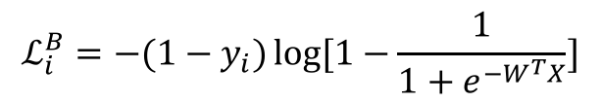
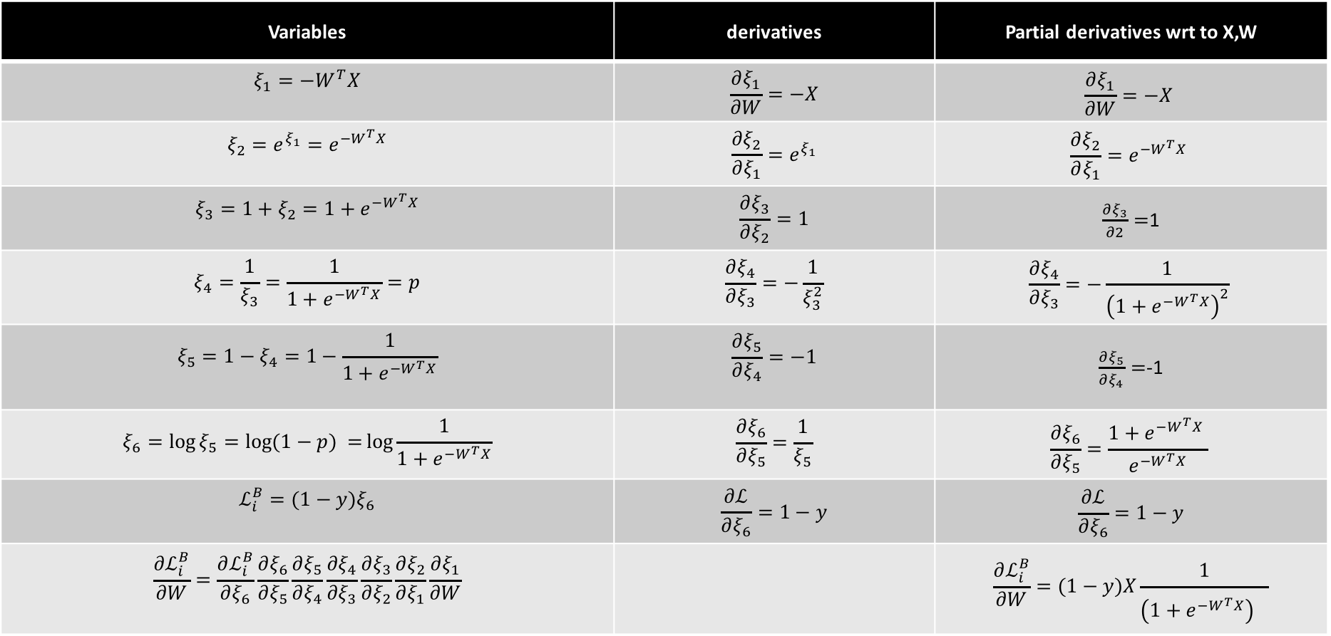
$$ℒ_{i}^{B}={−(1−y}_{i})\log{[1−\frac{1}{1+e^{−W^{T}X}}]}$$
Variables | derivatives | Partial derivatives wrt to X,W
$$ξ_{1}=−W^{T}X$$ | $$\frac{∂ξ_{1}}{∂W}=−X$$ | $$\frac{∂ξ_{1}}{∂W}=−X$$
$$ξ_{2}={e^{ξ_{1}}=e}^{−W^{T}X}$$ | $$\frac{∂ξ_{2}}{∂ξ_{1}}=e^{ξ_{1}}$$ | $$\frac{∂ξ_{2}}{∂ξ_{1}}=e^{−W^{T}X}$$
$$ξ_{3}=1+ξ_{2}=1+e^{−W^{T}X}$$ | $$\frac{∂ξ_{3}}{∂ξ_{2}}=1$$ | $\frac{∂ξ_{3}}{∂2}=$1
$$ξ_{4}=\frac{1}{ξ_{3}}=\frac{1}{1+e^{−W^{T}X}}=p$$ | $$\frac{∂ξ_{4}}{∂ξ_{3}}=−\frac{1}{ξ_{3}^{2}}$$ | $$\frac{∂ξ_{4}}{∂ξ_{3}}=−\frac{1}{{\left(1+e^{−W^{T}X}\right)}^{2}}$$
$$ξ_{5}=1−ξ_{4}=1−\frac{1}{1+e^{−W^{T}X}}$$ | $$\frac{∂ξ_{5}}{∂ξ_{4}}=−1$$ | $\frac{∂ξ_{5}}{∂ξ_{4}}=$-1
$$ξ_{6}=\log{ξ_{5}=\log{(1−p) =}\log{\frac{1}{1+e^{−W^{T}X}}}}$$ | $$\frac{∂ξ_{6}}{∂ξ_{5}}=\frac{1}{ξ_{5}}$$ | $$\frac{∂ξ_{6}}{∂ξ_{5}}=\frac{1+e^{−W^{T}X} }{e^{−W^{T}X}}$$
$$ℒ_{i}^{B}=(1−y)ξ_{6}$$ | $$\frac{∂ℒ}{∂ξ_{6}}=1−y$$ | $$\frac{∂ℒ}{∂ξ_{6}}=1−y$$
$$\frac{∂ℒ_{i}^{B}}{∂W}=\frac{∂ℒ_{i}^{B}}{∂ξ_{6}}\frac{∂ξ_{6}}{∂ξ_{5}}\frac{∂ξ_{5}}{∂ξ_{4}}\frac{∂ξ_{4}}{∂ξ_{3}}\frac{∂ξ_{3}}{∂ξ_{2}}\frac{∂ξ_{2}}{∂ξ_{1}}\frac{∂ξ_{1}}{∂W}$$ |  | $$\frac{∂ℒ_{i}^{B}}{∂W}=(1−y)X\frac{1}{{\left(1+e^{−W^{T}X}\right)}^{}}$$

Slide 27
Considerations
We still need to calculate the derivatives.
We need to set the learning rate.
Local vs global minima.
The full likelihood function includes summing up all individual ‘errors’. Sometimes this includes hundreds of thousands of examples.

Slide 28
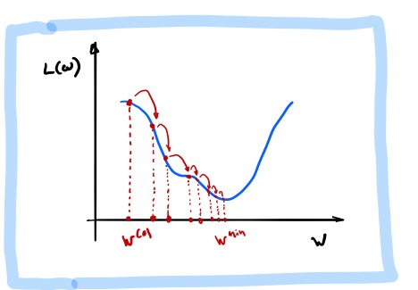
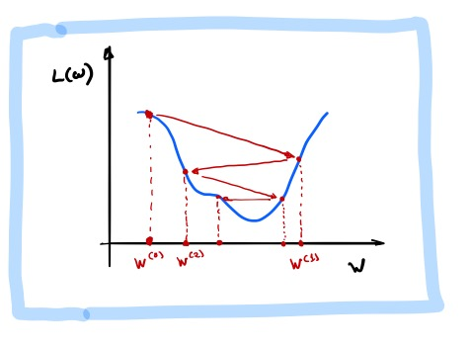
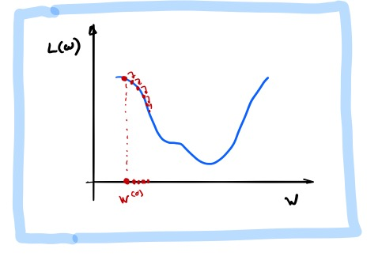
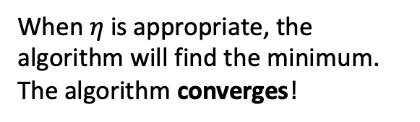
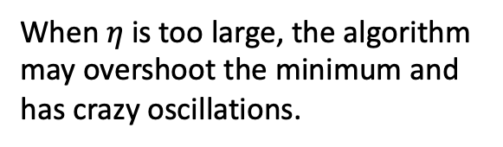
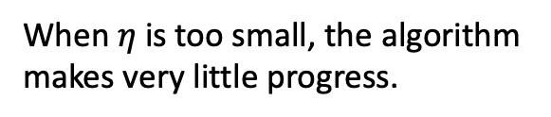
Learning Rate
Our choice of the learning rate has a significant impact on the performance of gradient descent.
When $η$ is too small, the algorithm makes very little progress.
When $η$ is too large, the algorithm may overshoot the minimum and has crazy oscillations.
When $η$ is appropriate, the algorithm will find the minimum.
The algorithm converges!

Slide 29



How can we tell when gradient descent is converging? We visualize the loss function at each step of gradient descent. This is called the trace plot.
While the loss is decreasing throughout training, it does not look like descent hit the bottom.
Loss is mostly oscillating between values rather than converging.
The loss has decreased significantly during training. Towards the end, the loss stabilizes and it can’t decrease further.

Slide 30
Learning Rate
There are many alternative methods which address how to set or adjust the learning rate, using the derivative or second derivatives and or the momentum.
More on this later.

Slide 31
Considerations
We still need to calculate the derivatives.
We need to set the learning rate.
Local vs global minima.
The full likelihood function includes summing up all individual ‘errors’. Sometimes this includes hundreds of thousands of examples.

Slide 32

Local vs Global Minima
If we choose $η$ correctly, then gradient descent will converge to a stationary point. But will this point be a global minimum?
If the function is convex then the stationary point will be a global minimum.

Slide 33
Local vs Global Minima
No guarantee that we get the global minimum.
Question: What would be a good strategy?
Random restarts
Add noise to the loss function

Slide 34

Exercise: Gradient Descent
The aim of this exercise is to perform gradient descent from scratch
Generate data from a function
Derive the derivative by hand and write gradient descent from scratch
Experiment with different learning rates and number of data points

